Slide 1
International Executive Committee Updates
Winter/Spring 2019

Slide 2
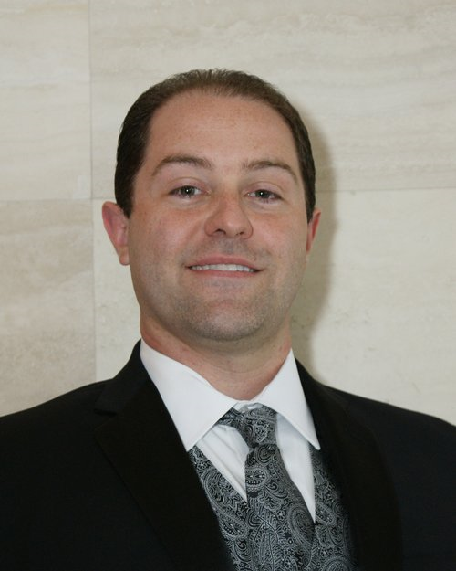
Grand Regent Mancini
The MASK
Enroll to get The MASK online www.kappapsimask.com
Since everyone already has their phone out – sign up now!
Only have ~800 Brothers signed up to receive regular online issues
Reach Out & Read
Goal to raise $50,000 by GCC, currently raised $20,000 as of 12/4/18
Public Relations
We want a big push to show our schools & communities the positive work we do
Try and get at least one philanthropy project noted in the media (school newspaper, local newspaper, news, etc) – Send info to publicrelations@kappapsi.org
Leadership Symposium 2020 – Info coming soon!

Slide 3
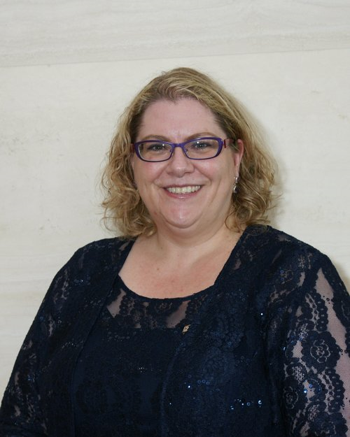
Grand Vice-Regent Askew
59th Grand Council Convention – SAVE THE DATE: July 17-21st, 2019
Grand Hyatt Washington, 1000 H Street NW
Introduction to the Convetion: https://youtu.be/gmN-e5Pt5vE
New activities coming to GCC including a student poster session and a virtual 5K Kappa Psi Foundation Fundraiser
Virtual 5K fundraiser will allow Brothers that are not able to attend GCC to join in the fun and help raise money for a good cause
A call for volunteers has been released – we are looking for those interested in participating in the career roundtables, as a CE or workshop moderator and as student poster mentors. Submit your interest through the survey https://form.jotform.com/83415051801144 or email me at claskew11122@gmail.com

Slide 4
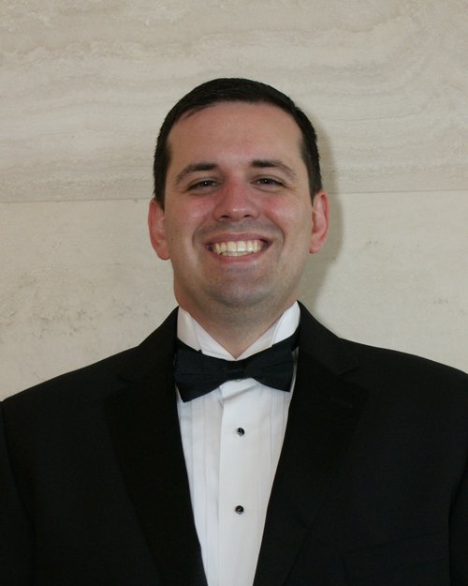
Grand Counselor Milton
All information regarding ordinances and taxes for chapters has been relayed to the Province Supervisors. Taxes should be filed annually based on the Chapter’s fiscal year (May 15th for most Chapters) using the IRS Form 990 (N or EZ). Ordinances should be reviewed annually.
Chapter and Province policy manual templates and a tip sheet are now available on the website.
A legislative/parliamentarian checklist is available on the website.
‘Disciplinary Process Form’ and ‘Risk Management Inquiry/Reporting Form’ are available on the website.
Policy updates have been relayed to the Supervisors.

Slide 5
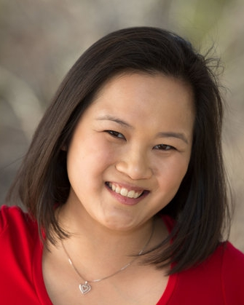
Grand Historian Buchanan
The History of Kappa Psi Pharmaceutical Fraternity: Our Modern History and Beginnings Revisited compiled and edited by Michael Cournoyer and Kali Weaver has been reduced in price to increase access for our Brothers. It is available for FREE on Kobo books and Barnes and Noble, $0.99 on iBooks, and $2.99 on Amazon.
To appreciate your history you must know your past. The MASK has been Kappa Psi’s main historical document over the years. The Executive Committee encourages all Brothers to explore our Fraternity’s past by reviewing previous editions of The MASK.
Chapter History Report Forms are due May 31 to coincide with the Collegiate Chapter Progress Report Form deadline but may be submitted at any time. Please use your chapter@kappapsi.org email to submit your report (see attached excel spreadsheet).
Notes:
Amazon: https://amzn.to/2TKs6zB (Lowest price we can set is $2.99 due to file size)
BN: https://www.barnesandnoble.com/w/the-history-of-kappa-psi-pharmaceutical-fraternity-michael-cournoyer/1122546422?ean=2940150916814 (FREE)
Apple: http://itunes.apple.com/us/book/id1032825390 (.99)
Kobo: https://www.kobo.com/us/en/ebook/the-history-of-kappa-psi-pharmaceutical-fraternity (FREE)

Slide 6
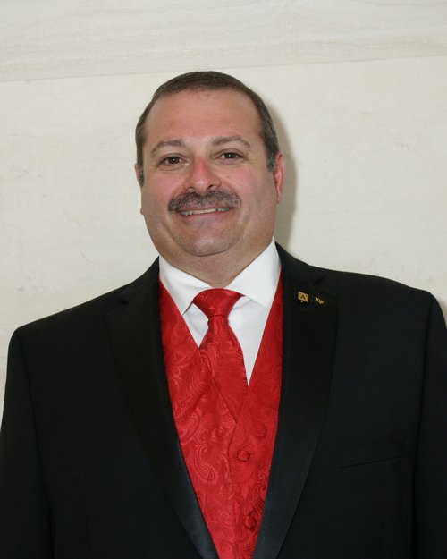
Grand Ritualist Starvaggi
Creating a Ritual Page for the website
Ensures ease of access to Brothers for important information
Will not post any protected ritual information
Continuing work on the “History of the Ritual”
Plan is to have ready by the Grand Council Convention
Working on ritual best practices webinar to be presented in Fall
Will have restricted access, so look for guidance on how to enroll
Be sure to teach Brothers the correct aspects of the Ritual
Correct motto
Correct grip & test and when to use which
Proper order of principles: Industry, Sobriety, Fellowship & High Ideals (NOT FISH)

Slide 7
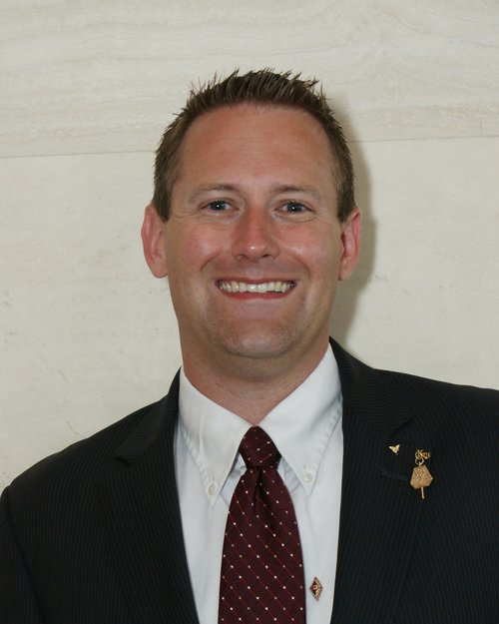
Graduate Member-At-Large Miller
With graduation (quickly) approaching, the graduate referral form is available to connect to a Graduate Chapter
2019 Voluntary Graduate Dues are due!
2018 set a recent record for dues payments
Coming Soon: Opt-in text reminders for voluntary dues
Graduate Chapter Reminders:
2019 Graduate Chapter Dues: Due by March 15th
Send updated Chapter Roster to The Central Office
Update the Central Office and Graduate Member-at-Large after officer elections
Check Chapter email addresses regularly
New giving society: “Society 1879”
Further details to follow on membership and benefits
Graduate Spotlight Nominations: Email gmatlarge@kappapsi.org

Slide 8
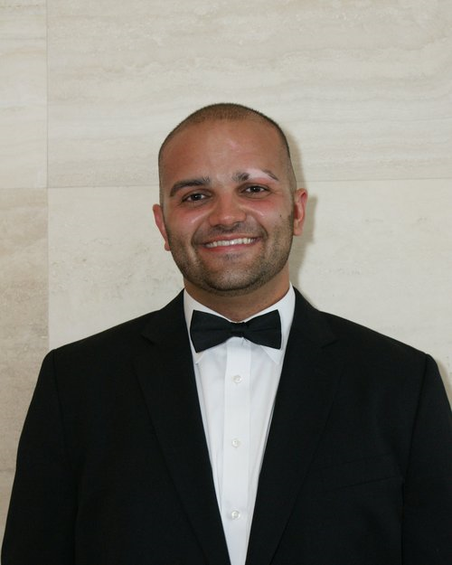
Collegiate Member-At-Large Nardollilo
Collegiate Webinar Series to occur throughout the Spring, follow listserv for updates. Now for points on the Chapter Progress Report Form!
Collegiate Open Forum to share ideas, ask questions, and receive feedback from other collegiate Brothers and IEC Members utilizing GoToWebinar
Encourage all new members to subscribe to Kappa Psi Social Media
Instagram: @KappaPsi Twitter: @kpsi Facebook: Kappa Psi
Texting Updates
Be sure to enrolled new year officers & GCDs at www.kappa-psi.com/texting
Check to make sure your chapter is up to date!
Collegiate “Best Practices” Manual
Written resource for new Regents, Chapter Officers, Province Officers and all interested Collegiates to serve as a “Go To Guide” to layout Kappa Psi’s Structure, basic requirements and best practices.
Updating Kappa Psi Promotional presence including PowerPoint presentation with supplemental video to positively promote our brand

Slide 9
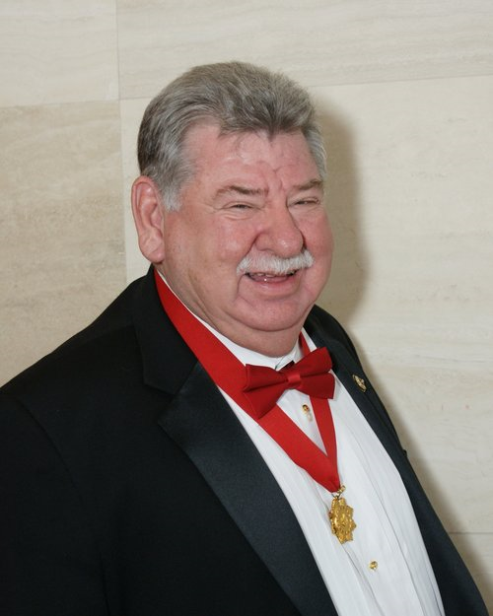
Executive Director Porter
Effective January 2019:
All dues not paid in full by October 15th (Fall dues) or February 15th (Spring dues) will be charged a 2% penalty per month until debt is paid (per constitution)
If dues not paid or payment plan not developed with the Executive Director, the EC will consider suspension of said Chapter
A 3% service charge fee will be applied for all credit card purchases

