Slide 1
Supervisor’s Report Gulf Coast Province//2016 Winter Conclave
Belma Muharemovic & Sanaz Farhadian

Slide 2
So You’ve Got Some New Supervisors…

Slide 3
Meet Belma…
College Life
Fall 2008 Initiate – Gamma Pi, St. Louis College of Pharmacy
Served as Treasurer and Pledgemaster
Last Vice-Satrap of Province VII 2011-2012
First Vice-Satrap of Mid-America Province 2012-2013
Collegiate Member, International Legislative Committee 2011-2013
MAP GCC Delegate 2013
PharmD in 2013
Grad Life
Registered Store Manager at Walgreens Specialty On-site Parkland Hospital, Farmington, MO
Kappa Psi involvement
Regent of St. Louis Graduate Chapter 2013 - ??
Assistant Supervisor Atlantic Province 2013-2015
Supervisor Gulf Coast Province 2015-2017
Social Life
Traveling!!
Wine
Cardinals Baseball

Slide 4
Meet Sanaz…
College Life
Spring 2005 Initiate – Delta Phi, UC San Diego
Vice-Regent 2005-2006
Regent 2006-2007
PharmD in 2008
Grad Life
Psychiatric Pharmacist at the Veterans Affairs Healthcare System
Kappa Psi involvement
Member of San Diego Graduate Chapter
Assistant Supervisor Northwest Province 2013-2015
Assistant Supervisor Gulf Coast Province 2015-2017
Experience on legislative, history, and ritual committees
Social Life
Being active – hikes, working out, dancing
Traveling
Walks on the beach

Slide 5
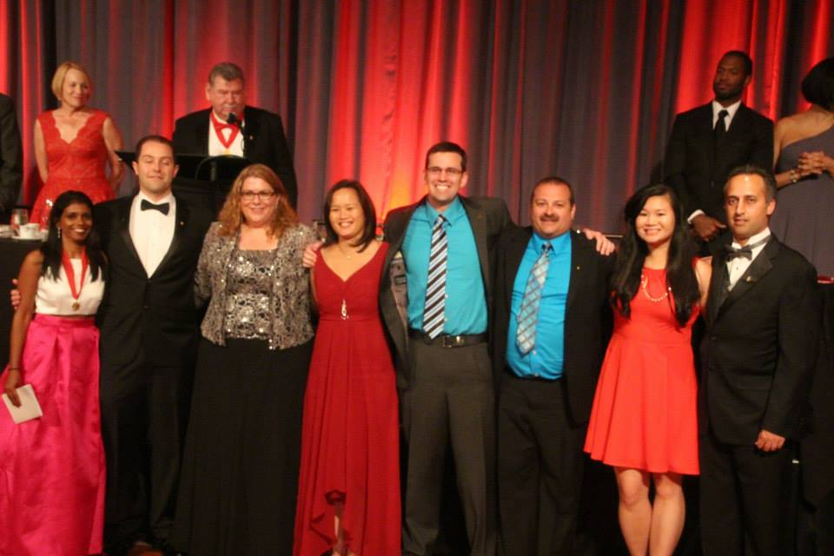
What’s New?
2015 – 2017 International Executive Committee
Grand Regent - Latha Radhakrishnan
Grand Vice Regent - Robert Mancini
Grand Counselor - Christy Askew
Grand Historian - Melissa Buchanan
Grand Ritualist - Jason Milton
Graduate Member at Large - Mike Starvaggi
Collegiate Member at Large - Karen Hoang

Slide 6
Congrats Gulf Coast Brothers:
Michelle Leatherwood (Gamma Zeta) and Fernando Diggs (Epsilon Kappa)
2015 Foundation Scholarship Winners
Grant McGuffey (Delta Gamma)
Appointed as Mountain East Province Assistant Supervisor 2015-2017

Slide 7
Congrats Gulf Coast Chapters:
Gamma Zeta
#7 Collegiate Chapter in Kappa Psi
Delta Gamma
Top Performing Chapter (ALMOST Top 10)

Slide 8
2015 Fall Packet
Kappapsi.org → Central Office → Collegiate Packets → 2015 Fall Packet

Slide 9
2015 Fall Packet
Letters of Correspondence
Fraternity Policies
Roster Forms
Regalia/Jewelry Ordering Information
Chapter History and Activity Report Forms
Dues Information
Filing Taxes
Local Ordinances Templates
Request for Awards
Other Important Fraternity Information

Slide 10
2015 Fall Packet - ROSTERS
Membership Rosters
How Central Office determines your Chapter dues
UPDATE EVERY FALL AND SPRING
Chapter Officers Addresses
UPDATE IMMEDIATELY AFTER ELECTIONS
Faculty Members Roster
REVIEW ANNUALLY AND UPDATE PRN

Slide 11
2015 Fall Packet – CENTRAL OFFICE DUES
Collegiate Chapter Dues - $20/Brother bi-annually
DUE FEBRUARY 15 & OCTOBER 15 every year
Graduate Chapter Dues - $200/Chapter annually
$150 + $50 Risk Management Fee
DUE MARCH 15 every year
Risk Management Fee
Per capita fee for Collegiate Chapters
Watch for invoice from Central Office – up to $7/Brother
DUE OCTOBER 15
$50 flat fee for Graduate Chapters
Voluntary Graduate Dues
Various donation levels
$50 annually gets you the MASK
Paid online
Initiation Fee
$45/new initiate
Paid within 7 days of initiation
Submit M-Cards concurrently

Slide 12
About those M-Cards…
Online Form
Every new initiate must fill out in order to be recognized as an official Brother
$45 initiation fee must be sent immediately upon completion
Brothers will receive their M-Cards in the mail along with a copy of the Constitution and By-Laws
Kappapsi.org → Login (top right corner) → Chapter Login → pick Chapter name in dropdown & enter password → Click “Apply for M-Card”
http://kappapsi.org

Slide 13
2015 Fall Packet - Taxes
Chapters must file IRS Form 990-n or 990/990-EZ annually
Due date depends on your fiscal year – contact IRS if unsure
Most chapters due May 15th of every year
Failure to file for 3 consecutive years can result in loss of tax-exempt status
Need EIN (Employer Identification Number) or Tax ID number
Contact Central Office if you don’t know your Chapter’s EIN
See PDF document in Fall Packet for complete instructions and details

Slide 14
2015 Fall Packet – By-Laws
Local Chapter Ordinances should be reviewed annually and updated PRN (aim for min. once every 4 years)
Updates are submitted electronically to the Grand Counselor for Legislative Committee review
Most GCP Chapters have updated within last 4 years
Last-approved version of ordinances posted on national website
Contact grandcounselor@kappapsi.org

Slide 15
Chapter | Last Ordinance update | Tax year last filed
Psi | December 2015 | Dec 2014
Beta Rho | June 2015 | Dec 2014
Gamma Zeta | April 2015 | Dec 2014
Gamma Omega | March 2015 | Jul 2015
Delta Gamma | April 2014 | May 2015
Delta Eta | August 1987 | Dec 2014
Epsilon Kappa | April 2015 | Dec 2014
Epsilon Lambda | April 2015 | N/A – school EIN
Auburn Graduate | July 2009 | Dec 2014
Birmingham Graduate | May 2011 | Dec 2014
Louisiana Graduate | August 1987 | NEEDS EIN
Middle Tennessee Graduate | June 2011 | NEEDS EIN
North Alabama Graduate | March 2014 | N/A – new 2015
South Alabama Graduate | May 2011 | NEEDS EIN
Tennessee Graduate | February 1983 | Dec 2014

Slide 16
Communication
Chapter email accounts
chaptername@kappapsi.org
Login either on Kappapsi.org or Gmail
Contact CO for password resets
Where Chapter Invoices are sent
Kappa Psi Google Group
https://www.kappapsi.org/communications
Social Media
Facebook- search for Kappa Psi
Twitter- KPsi

Slide 17
Upcoming Deadlines
February 15
Collegiate Chapter Dues to Central Office
Submit Membership Roster, Faculty Members Roster, Chapter Officers Addresses Form to Central Office
March 1 - MASK article and photo submission for Spring Issue
March 15 – Graduate Chapter Dues to Central Office
April 15
Early Chapter Progress Report Form (for 100 bonus points) to Awards Committee Chairperson(s)
GCD Award application to GCD Development Committee Chairperson(s)
May 15
Deadline to file taxes for most Chapters
Chapter Progress Report Form absolute deadline
Graduate Chapter of the Year Form to Graduate Chapter Committee Chairperson(s)
Applications for Kappa Psi Foundation Scholarships
June 14 - List of Graduating Brothers with forwarding addresses to Central Office
June 23 – Applications for Scholarship Tray Award to Central Office
June 30 – Complete Chapter History Report form for past semester/year
July 1 – MASK article and photo submission for Summer Issue

Slide 18
Policy Updates – Kappa Psi Apparel
Kappa Psi has contracted with Affinity Consultants to handle the fraternity trademarks when chapters want to order custom apparel or other items
Go to greeklicensing.com and you will be able to search under the fraternity name and your geographic region to find vendors licensed to produce Kappa Psi items and links to their individual websites
If you are dealing with a vendor who is not yet licensed, they can apply for a license through the same website
Vendors are usually approved the same day
Why are we doing this?
To protect our copyrights & trademarking. National law says if an entity isn't actively protecting their trademarks they will lose their trademarks. Affinity was chosen as the entity to help us with this.
Royalties are paid to Kappa Psi by the vendors, however this shouldn’t result in an increased cost to the chapters. Most vendors already build royalty costs into their pricing from the beginning (this is true of any entity already licensed).

Slide 19
Policy Updates - Risk Management
Three main updates
1) The section on policy violations has been updated to include that any violation of the Risk Management policy should be immediately reported to the Chapter GCD and/or Faculty Advisor to determine if anything needs to be done at the School level.
It is especially important that the Chapter Regent, Pledgemaster & GCD read through this section thoroughly.
If a violation of the policy is noted and the policy is not properly followed, then it could lead to increased liability on behalf of the Chapter.

Slide 20
Risk Management Updates – cont’d
2) Within the policy violations section there is a list of possible sanctions to be imposed.
Please note, these are possible sanctions that a Chapter may hand down to a member guilty of violating the policy (after due process as outlined in By-Law III of the Constitution) and the Chapter is free to chose and/or all of the sanctions noted based on their judiciary review.
3) The new policy requires that all Brothers (since this is new), as well as all pledges, sign the acknowledgement form at the beginning of the pledge period (all current Brothers should sign ASAP).
These signed forms should then be kept on file with the Chapter (or by the Chapter's Risk Management Chair) for the duration of the Brothers time as a collegiate member of that chapter.

Slide 21
Risk Management
Policy to be reviewed annually for changes
Policy to be reviewed every semester by each collegiate Brother and Pledge
Policy should be in mind when planning any chapter/province events
The following actions are considered violations:
Hazing
Alcohol and substance abuse
Sexual harassment
Human dignity
Fire, health, and safety

Slide 22
Policy Updates – Graduate Chapter Establishment/Reactivation
Policy 14 (2 changes)
Step 1
Step 1 was amended to better define the area where graduate Brothers must live to qualify as one of the 5 signatures on the formal letter to the Central Office to begin the process of starting or reactivating a chapter
Brothers need to live in the city, county, or predefined geographic region of the graduate chapter in order to ensure adequate support and starting membership for that chapter
Step 5
Step 5 was also changed to require that in order to activate or reactivate a graduate chapter, the proposed group must complete 2 activities instead of 1 and submit a report of each activity within 30 days of the event to receive credit

Slide 23
New Policy – Social Media
Policy 20 (Social Media) addresses appropriate use of social media by Kappa Psi brothers containing Kappa Psi-related items
Key points:
Always follow applicable federal, state, local laws and school rules when posting on social media as it pertains to posting what may be privileged or sensitive personal information
Always follow most stringent rules>>If state law is more strict than fraternity policy, follow state law
Materials posted in relation to the fraternity should always be professional and courteous at all times
Ritual related information should never be posted without first consulting the Grand Ritualist to determine if the information is appropriate to post
If contacted by any non-Kappa Psi entity about inappropriate posts related to Kappa Psi, it is the responsibility of the person, chapter, or province, to contact the Grand Regent and/or Grand Vice Regent and Central Office BEFORE responding

Slide 24
Social Media Policy cont’d
Members of the international pages must be Brothers
People requesting addition to the International Kappa Psi pages must be verified to be a Brother by the Grand Regent or a Brother they designate
The Central Office and Executive Committee reserve the right to delete any pictures, comments, or posts that are deemed to violate the Constitution and Bylaws, risk management or picture policy, or are deemed to be unprofessional or inappropriate
Violation of this policy will result in the post being deleted and the Brother receiving a copy of the policy as a reminder
Subsequent violations may result in the Brother’s access to that account being revoked and being referred to their chapter for disciplinary action

Slide 25
Picture Policy REVIEW
Applies to the MASK, newsletters, websites and social media
No alcohol in pictures: no photos of drinking games
No sexist photos or those with overly sexual material
No obscene gestures or attire
No racism
No illegal activities

Slide 26
Hazing Policy REVIEW
Our policy on hazing refers to any form of physical or mental harassment
No Member or Pledge will be required, coerced, forced, or influenced in any way to do anything that would be unbecoming of a Brother of Kappa Psi Pharmaceutical Fraternity, Inc.
Any activity or action that would cause a Member or Pledge to lose dignity might involve hazing
It includes, but is not limited to:
Forced physical exercise
Activities which may cause physical or psychological harm to an individual
Activities which would require an unreasonable amount of time to complete
Any activity that would degrade someone or cause them to be an object of ridicule
Required consumption of any item
Compelling a person to participate in an event that is contrary to their moral or religious beliefs, or that is illegal

Slide 27
Alcohol Policy REVIEW
The Fraternity policy refers to substance abuse in general, be it legal or illegal, but specifically when dealing with alcohol, chapters should:
Not have alcohol as a central focus of an event
Not spend chapter funds to purchase alcohol (BYOB)
No mass containers (kegs, punch bowls, etc)
Ensure all people drinking are over 21
Not allow any alcohol at rush events or pledge events
Initiate ways to prevent impaired driving (DD’s, arrange rides)

Slide 28
Chapter Delegates – YOUR DUTIES
Report back to your Chapter with policy updates
Ensure that your Chapter conducts a review of these policies with all Collegiate Brothers AS SOON AS POSSIBLE – preferably your next Chapter meeting
E-mail your GCD and CC us when this meeting takes place
Your Chapter MUST conduct or schedule this meeting by JANUARY 31
Reach out to Province Supervisors for help
Complete Policy Manual available online https://kappapsi.org/img/uploads/files/Policy%20Manual/Kappa%20Psi%20Policy%20Manual%209.7.2015.pdf

Slide 29
Upcoming Province Assemblies & Events
Atlantic Province- Raleigh, NC, Jan 22–24
Southeast Province- Orlando, FL, Feb 12-14
Northwest Province- Portland, OR, Feb 12 -14
Pacific West Province- Sacramento, CA, March 18-20
Southwest Province, March 18-20
Northern Plains Province- Omaha, NE, April 1-3
Great Lakes Province- Cleveland, OH, April 1-3
Mountain East Province- Washington, DC, April 8-10
Northeast Province- Bangor, ME, April 8-10
Mid America Province- Rockford, IL, April 15-17
Beta Pi Centennial- Spokane, WA, April 15th
Beta Omicron Centennial- Seattle, WA, April 23rd

Slide 30
Questions?

Slide 31
Contact Your Supervisors…
Belma Muharemovic
Belma.Muharemovic@gmail.com
314-939-8686
Facebook
Sanaz Farhadian
SanazFarhadian@gmail.com

